Slide 1




Trends in International Mathematics and Science Study (TIMSS)
Results of Georgia 2019
National Assessment and Examinations Center
Tbilisi, 2020

Slide 2
The Goal and Participants of TIMSS
The main purpose of TIMSS is to contribute to teaching and learning of mathematics and science, as well as to assist participating countries in improving education policies and practices in this direction;
TIMSS is conducted by the International Association for the Evaluation of Educational Achievement (IEA) in various countries around the world every 4 years since 1995;
Georgia first participated in the survey in 2007 and has since participated in 2011, 2015 and 2019 cycles;
Georgia was represented by both 4th and 8th grades in each research cycle;
From 2019, TIMSS switched to electronic assessment (e-TIMSS);
64 countries participated in TIMSS 2019. 58 countries and 6 regions participated in the fourth grade assessment, and 39 countries and 7 regions participated in the eighth grade assessment.

Slide 3
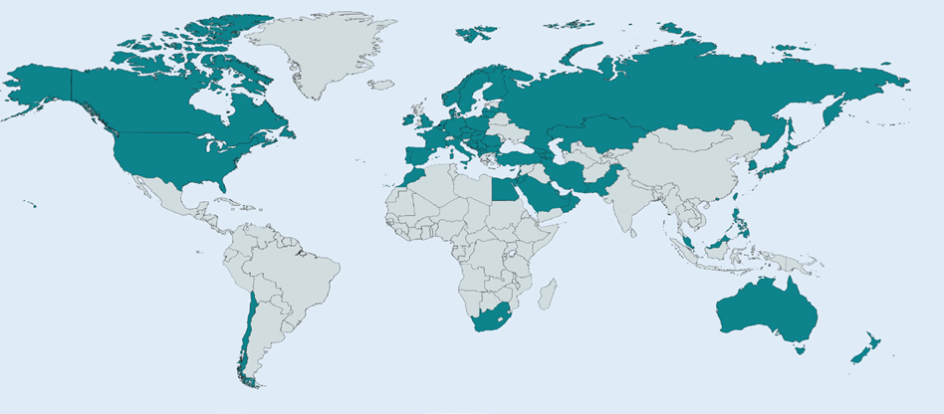
TIMSS Participants from Georgia:
226 schools;
154 fourth and 145 eighth grade;
6 002 fourth graders;
5,698 eighth graders;
214 School Principal;
1,716 teachers;
Parent / guardian of 5 931 fourth graders.
Georgia conducted a Bridge Study in order to switch to e-assessment.
School principals, teachers, students, and parents completed questionnaires specially designed for them.
TIMSS 2019 Participants:
Albania, Australia, Armenia, Austria, Azerbaijan, Bahrain, Belgium (Flemish), Bosnia and Herzegovina, Bulgaria, Canada (with Ontario and Quebec as benchmarking systems), Chile, Chinese Taipei, Croatia, Cyprus, Czech Republic, Denmark, Egypt, England, Finland, France, Georgia, Germany, Hong Kong SAR, Hungary, Islamic Republic of Iran, Ireland, Israel, Italy, Japan, Jordan, Kazakhstan, Republic of Korea, Kosovo, Kuwait, Latvia, Lebanon, Lithuania, Republic of North Macedonia, Malaysia, Malta, Montenegro, Morocco, Netherlands, New Zealand, Northern Ireland, Norway, Oman, Pakistan, Philippines, Poland, Portugal, Qatar, Romania, Russian Federation (with Moscow as a benchmarking system), Saudi Arabia, Serbia, Singapore, Slovak Republic, South Africa, Spain (with Madrid as a benchmarking system), Sweden, Turkey, United Arab Emirates (with Abu Dhabi and Dubai as benchmarking systems), United States.

Slide 4


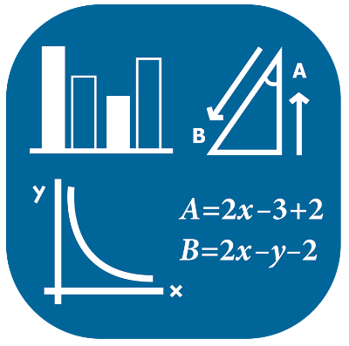

TIMSS 2019: Achievements of Georgia
International Average 500 Points
Mathematics
4th Grade
Natural Sciences
4th Grade
482 Points
454 Points
Mathematics
8th Grade
Science
8th Grade
461 Points
447 Points

Slide 5
TIMSS 2019: Achievements in Mathematics Grade 4
Country | Achievement | Country | Achievement | Country | Achievement
Singapore | 625 | Turkey | 523 | Bahrain | 480
Hong Kong | 602 | Sweden | 521 | Northern Macedonia | 472
South Korea | 600 | Germany | 521 | Montenegro | 453
Taiwan | 599 | Poland | 520 | Bosnia and Herzegovina | 452
Japan | 593 | Australia | 516 | Qatar | 449
Russia | 567 | Azerbaijan | 515 | Kosovo | 444
Northern Ireland | 566 | Bulgaria | 515 | Islamic Republic of Iran | 443
England | 556 | Italy | 515 | Chile | 441
Ireland | 548 | Kazakhstan | 512 | Oman | 431
Latvia | 546 | Canada | 512 | Saudi Arabia | 398
Norway | 543 | Slovakia | 510 | Morocco | 383
Lithuania | 542 | Croatia | 509 | Kuwait | 383
Austria | 539 | Malta | 509 | South Africa | 374
Netherlands | 538 | Serbia Spain | 508 502 | Pakistan | 328
USA | 535 |  |  | Philippines | 297
Czech Republic | 533 | International Average | 500 | Benchmarking Participants
Belgium (Flemish) | 532 | Armenia | 498 | Moscow (Russia) | 593
Cyprus | 532 | Albania | 494 | Dubai | 544
Finland | 532 | New Zealand | 487 | Quebec (Canada) | 532
Portugal | 525 | France | 485 | Madrid (Spain) | 518
Denmark | 525 | Georgia | 482 | Ontario (Canada) | 512
Hungary | 523 | United Arab Emirates | 481 | Abu Dhabi | 441

Slide 6
TIMSS 2019: Achievements in Mathematics Grade 8
Country | Achievement | Country | Achievement | Country | Achievement
Singapore | 616 | Cyprus | 501 | Lebanon | 429
Taiwan | 612 | Portugal | 500 | Jordan | 420
South Korea | 607 | International Average | 500 | Egypt | 413
Japan | 594 | Italy | 497 | Oman | 411
Hong Kong | 578 | Turkey | 496 | Kuwait | 403
Russia | 543 | Kazakhstan | 488 | Saudi Arabia | 394
Ireland | 524 | France | 483 | South Africa | 389
Lithuania | 520 | New Zealand | 482 | Morocco | 388
Israel | 519 | Bahrein | 481 | Benchmarking Participants
Australia | 517 | Romania | 479 | Moscow (Russia) | 575
Hungary | 517 | United Arab Emirates | 473 | Quebec (Canada) | 543
USA | 515 | Georgia | 461 | Dubai | 537
England | 515 | Malaysia | 461 | Ontario (Canada) | 530
Finland | 509 | Islamic Republic of Iran | 446 | West Cape | 441
Norway | 503 | Qatar | 443 | Abu Dhabi | 436
Sweden | 503 | Chile | 441 | Gauteng | 421

Slide 7
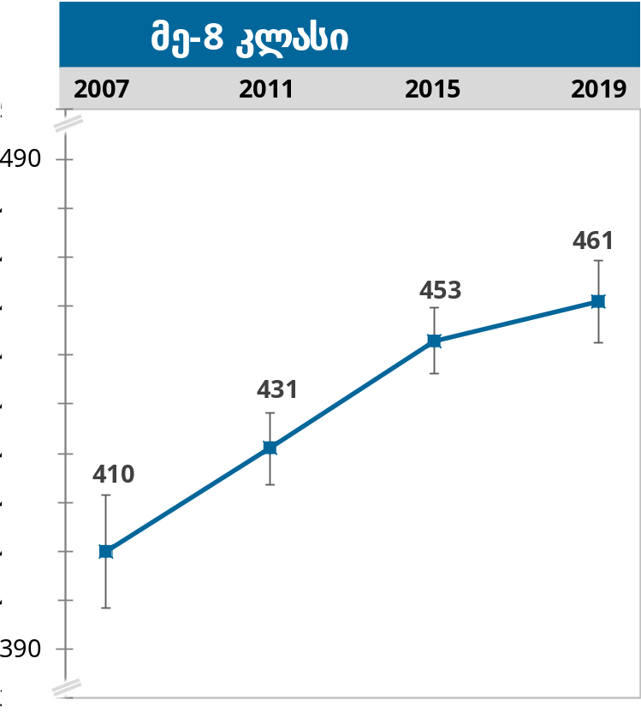
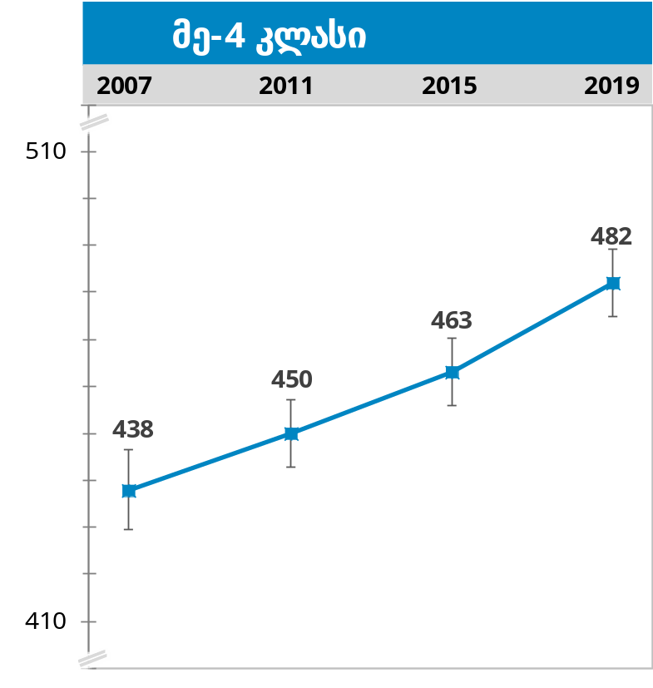
TIMSS 2019: Achievement Dynamics in Mathematics
In the 2019 cycle, the achievements of fourth-graders in Georgia have improved statistically. Georgia is also among the five countries that have increased the level of achievement the most compared to the 2015 cycle. The growth trend is maintained in the eighth grade results as well.
Grade 8
Grade 4

Slide 8
TIMSS 2019: Achievement in Science Grade 4
Country | Achievement | Country | Achievement | Country | Achievement
Singapore | 595 | Austria | 522 | Bosnia and Herzegovina | 459
South Korea | 588 | Bulgaria | 521 | Georgia | 454
Russia | 567 | Slovakia | 521 | Montenegro | 453
Japan | 562 | Northern Ireland | 518 | Qatar | 449
Taiwan | 558 | Netherlands | 518 | Islamic Republic of Iran | 441
Finland | 555 | Germany | 518 | Oman | 435
Latvia | 542 | Serbia | 517 | Azerbaijan | 427
Norway | 539 | Cyprus | 511 | Northern Macedonia | 426
USA | 539 | Spain | 511 | Kosovo | 413
Lithuania | 538 | Italy | 510 | Saudi Arabia | 402
Sweden | 537 | Portugal | 504 | Kuwait | 392
England | 537 | New Zealand | 503 | Morocco | 374
Czech Republic | 534 | Belgium (Flemish) | 501 | South Africa | 324
Australia | 533 | International Average | 500 | Pakistan | 290
Hong Kong | 531 | Malta | 496 | Philippines | 249
Poland | 531 | Kazakhstan | 494 | Benchmarking Participants
Hungary | 529 | Bahrein | 493 | Moscow (Russia) | 595
Ireland | 528 | Albania | 489 | Dubai | 545
Turkey | 526 | France | 488 | Ontario (Canada) | 524
Croatia | 524 | United Arab Emirates | 473 | Madrid (Spain) | 523
Canada | 523 | Chile | 469 | Quebec (Canada) | 522
Denmark | 522 | Armenia | 466 | Abu Dhabi | 418

Slide 9
TIMSS 2019: Achievement in Science Grade 8
Country | Achievement | Country | Achievement | Country | Achievement
Singapore | 608 | Hong Kong | 504 | Islamic Republic of Iran | 449
Taiwan | 574 | Italy | 500 | Georgia | 447
Japan | 570 | International Average | 500 | Kuwait | 444
South Korea | 561 | New Zealand | 499 | Saudi Arabia | 431
Russia | 543 | Norway | 495 | Morocco | 394
Finland | 543 | France | 489 | Egypt | 389
Lithuania | 534 | Bahrein | 486 | Lebanon | 377
Hungary | 530 | Cyprus | 484 | South Africa | 370
Australia | 528 | Kazakhstan | 478 | Benchmarking Participants
Ireland | 523 | Qatar | 475 | Moscow (Russia) | 567
USA | 522 | United Arab Emirates | 473 | Dubai | 548
Sweden | 521 | Romania | 470 | Quebec (Canada) | 537
Portugal | 519 | Chile | 462 | Ontario (Canada) | 522
England | 517 | Malaysia | 460 | West Cape | 439
Turkey | 515 | Oman | 457 | Gauteng | 422
Israel | 513 | Jordan | 452 | Abu Dhabi | 420

Slide 10
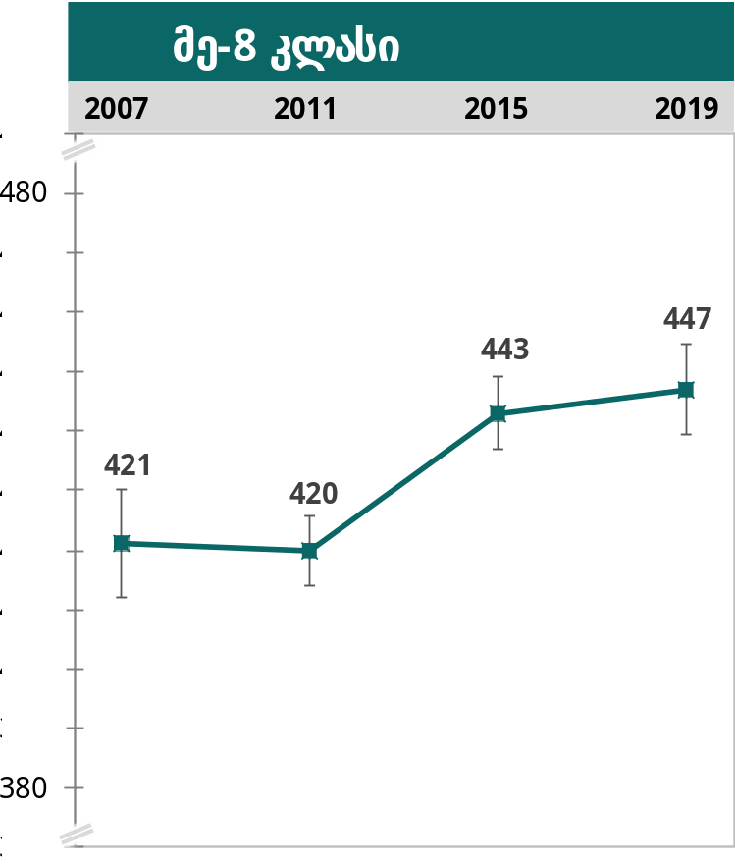
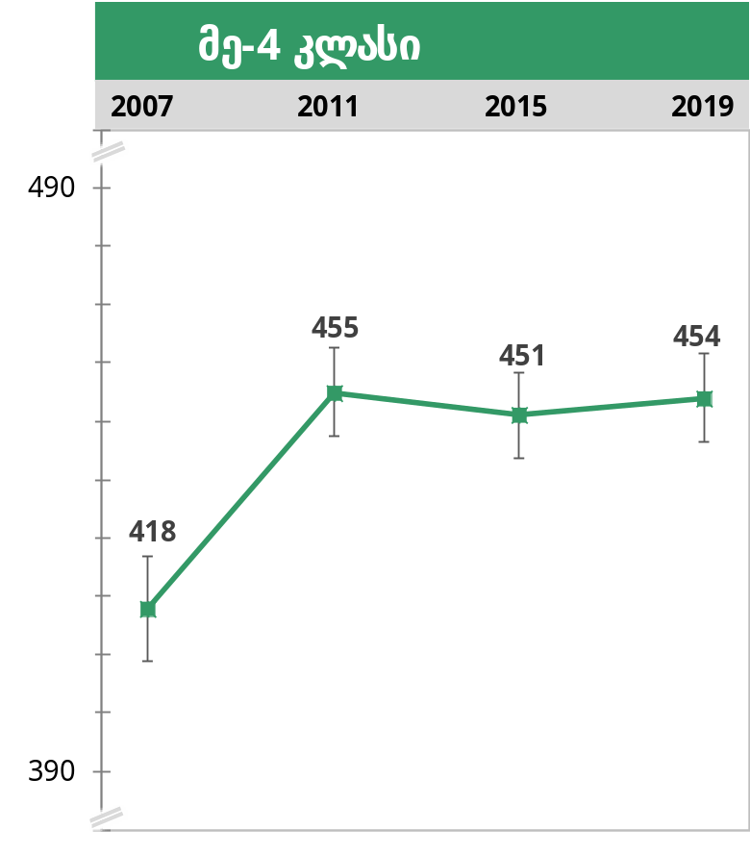
TIMSS 2019: Achievement Dynamics in Science
Georgia's score in both the fourth and eighth grades compared to the previous research cycles has increased slightly, however this does not indicate a statistically significant progress.
Science Grade 8
Science Grade 4

Slide 11

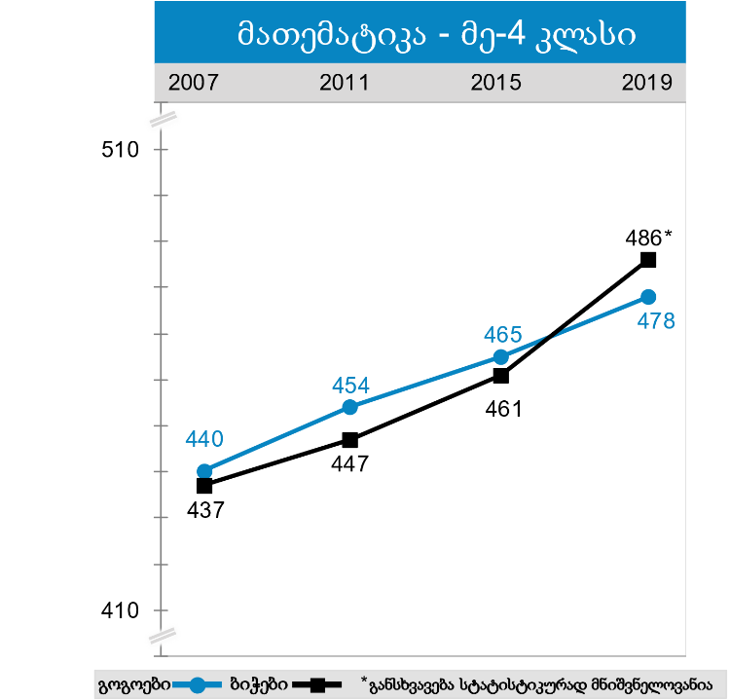
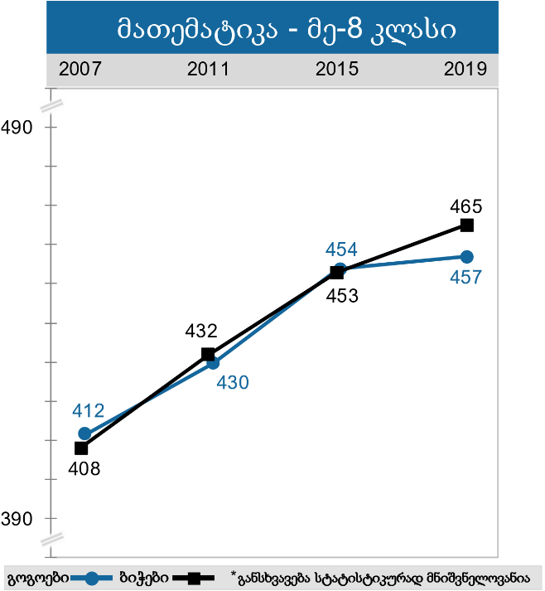
TIMSS 2019: Average Achievement by Gender (Girl/boy)
According to 2019 data, the achievements of 4thgrader boys are statistically significantly higher than the achievements of girls, although Georgia is among the 3 countries (South Korea, Malta, Georgia) where this difference is the slightest.
Mathematics Grade 4
Mathematics Grade 8

Slide 12

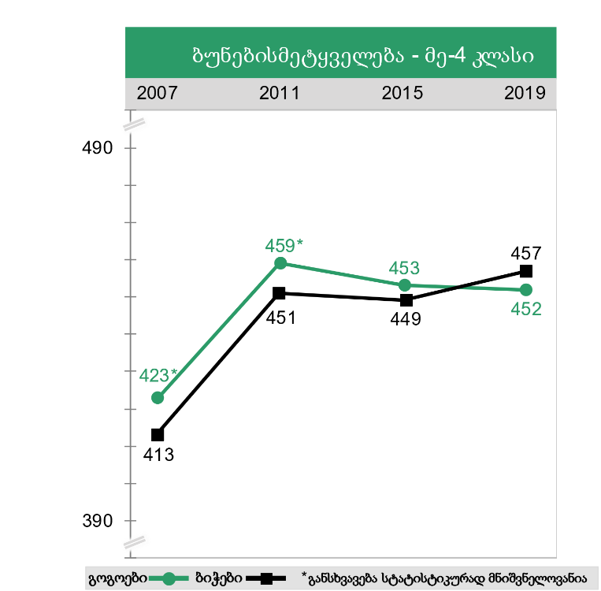
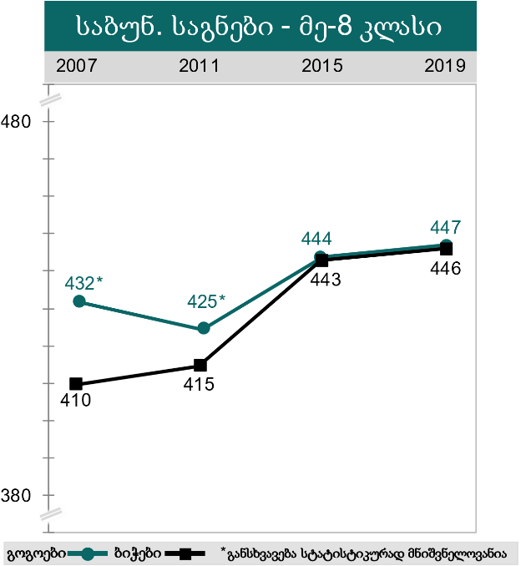
TIMSS 2019: Average Achievement by Gender (Girl/boy)
According to 2019 data, the achievements of girls and boys in more than half of the participating countries do not differ by gender, including: Georgia, Finland, Latvia, Azerbaijan, Norway, Poland, France, Sweden, the Netherlands, Denmark and others.
Science Grade 4
Science Grade 4

Slide 13
TIMSS 2019: Achievement According to School Status (Public/Private)
As in previous research cycles, in 2019, private school achievement in mathematics still outperformed public school results, although it is clear that the gap between private and public schools is narrowing.

Slide 14
TIMSS 2019: Achievement According to School Status (Public/Private)
According to the results of 2019, the achievements of private schools in Science (physics, chemistry, biology, earth sciences) are still higher than the achievements of public schools, although the gap between the achievements of private and public schools is decreasing.
public
private
public
private

Slide 15
TIMSS 2019: Achievement According to School Location (Urban/Rural)
According to 2019 data, fourth-graders from rural areas have improved their achievement statistics significantly.
For the first time since 2007, based on 2019 data, we can conclude that the differences between rural and urban schools are not statistically significant and that the gap is narrowing down.

Slide 16
TIMSS 2019: Achievement According to School Location (Urban/Rural)
Both 4th and 8th graders from rural areas have improved their achievement in contrast to urban schools. This increase is statistically significant in the 4th grade.

Slide 17
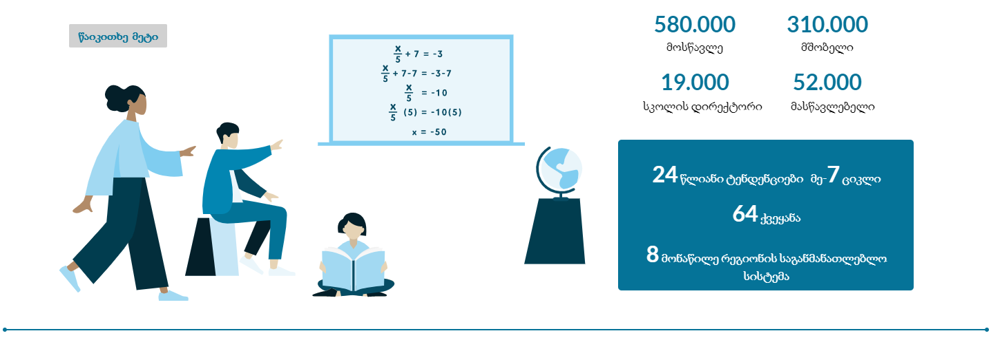
TIMSS 2019 Infographic Dashboard in Georgian
For the first time in the 12 years of the study, any interested person will have an opportunity to visit the TIMSS website and receive information in Georgian about the main data of the 2019 cycle: https://datastudio.google.com/s/okXY6XCXPr8

Slide 18
Thanks for Your Attention!

