Slide 1






Programme for International Student Assessment
2018

Slide 2
Major goals of PISA assessment
Major goals of PISA assessment are to determine:
How students are able to acquire a knowledge and skills necessary for any individual to participate in social and economic processes i.e. much less attention to reproduction of knowledge;
How they are able to transfer the knowledge – use it in an unknown context and everyday life, in the school environment and outside of it (OECD (2019), PISA 2018 Results, Vol. I, 28);
The extent of students’ general competencies: learning independently, communication, adaptation, problem solving, the use of ICT skills.

Slide 3
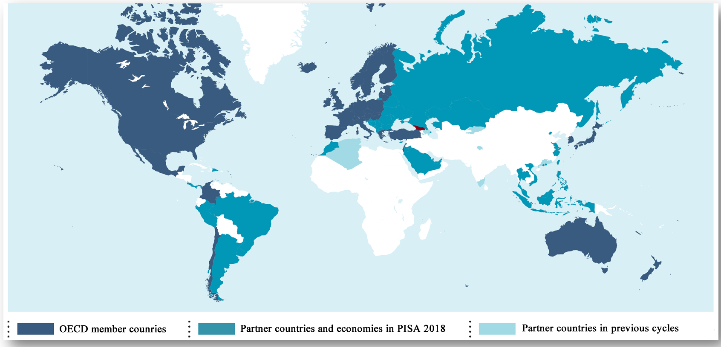
PISA 2018: Characteristics (1)
Georgia*: 5 572 students (population above 15 - 38 489) 326 schools. Coverage index of students 15 years old - 83%, cf. OECD >80%;
Approximately 600 000 students from 79 counties (PISA population – 32 million).

Slide 4
Characteristics of PISA 2018 (2)
In 2018, like in 2000 and 2009, reading was the major domain of the assessment;
Global competencies and financial literacy were the nonobligatory domains in 2018. Students from Georgia participated in the latter;
In 70 countries out of 79, students wrote tests on computers (CBA). First time in PISA history, assessment test for reading was prepared in CAT format;
PISA tests in CBA format were written first time in 8 countries – Albania, Georgia, Indonesia, Kazakhstan, Kosovo, Malta, Panama, Serbia);
PISA tests in PBA format were written in 9 counties – Argentina, Jordan, Lebanon, Republic of Moldova, Republic of Northern Macedonia, Romania, Saudi Arabia, Ukraine, Vietnam.

Slide 5
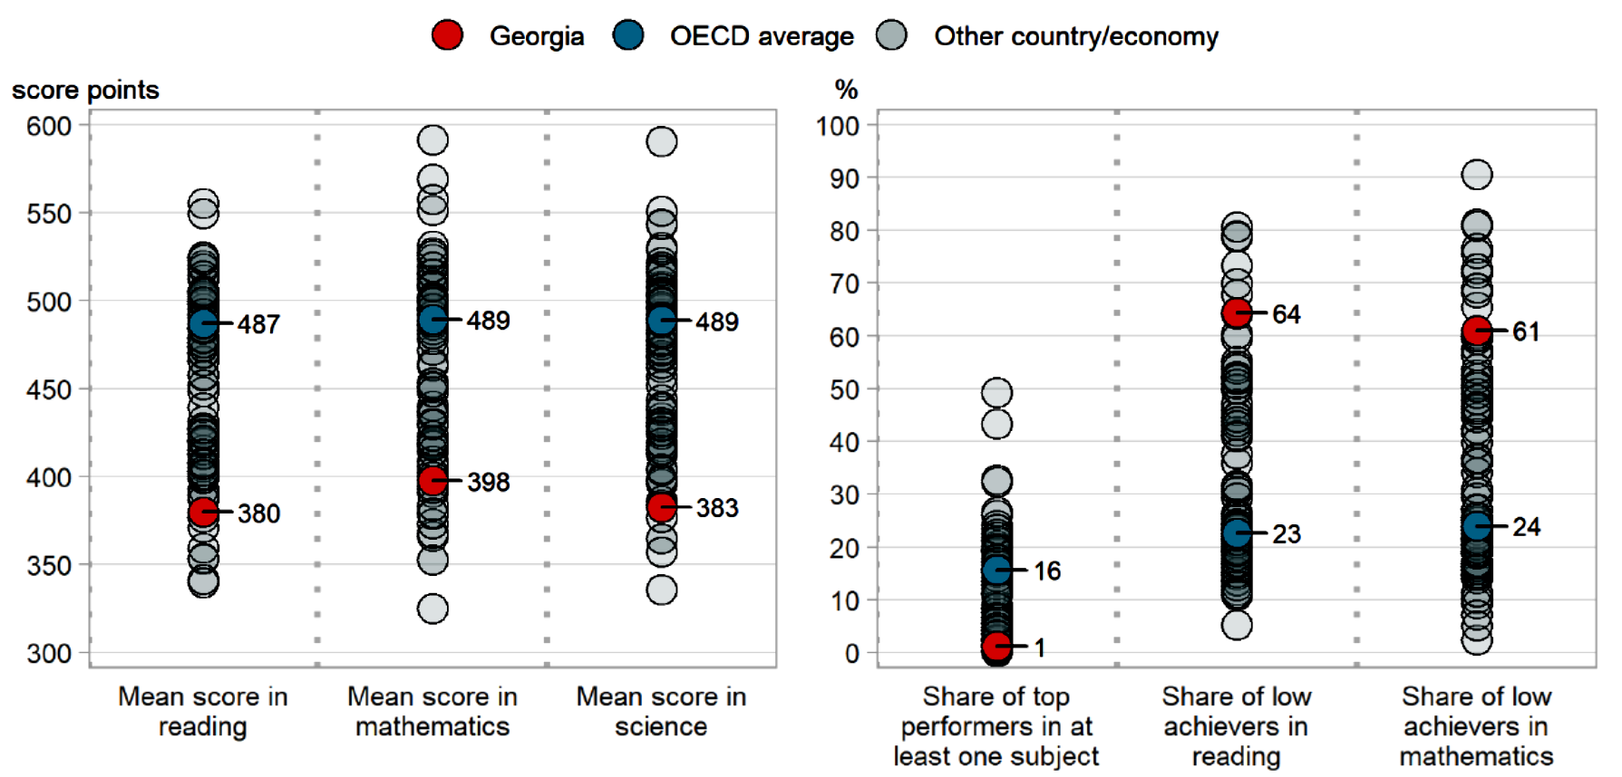
PISA 2018: Results

Slide 6
Results – Short and long term tendencies
 |  | 2009 | 2012 | 2015 | 2018
Reading | Georgia | 374 | m | 401* | 380
 | OECD | 493 | 493 | 490 | 487
Math | Georgia | 379 | m | 404 | 398
 | OECD | 496 | 490 | 487 | 489
Natural Sciences | Georgia | 373 | m | 411* | 383
 | OECD | 501 | 493 | 491 | 489

Slide 7
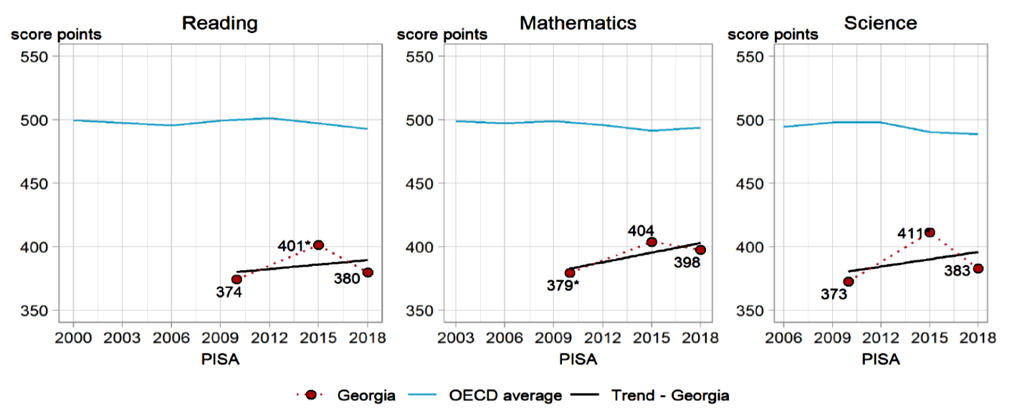
ტენდენცია 10 წლიან პერსპექტივაში
Reading | Georgia | 6 point improvement
 | OECD | 6 point deterioration
Math | Georgia | 19 point improvement
 | OECD | 7 point deterioration
Natural Sciences | Georgia | 10 point improvement
 | OECD | 12 point deterioration

Slide 8
PISA 2018: Assessment framework of cognitive domain of reading
PISA defines reading literacy as “understanding, using and reflecting on written texts, in order to achieve one’s goals, to develop one’s knowledge and potential, and to participate in society”. (OECD (PISA 2018) Reading Framework, 8);
Each subdomain of reading domain defines assertions of knowledge and skills. Test design and instruments of assessment are based on these assertions;
According to the framework for assessing the reading literacy of students, reading and understanding is a result of three components – reader, text and activity, reading items and item goals. These there components are connected to the socio-cultural context. We can imagine different situation where reading process takes place.
Diagram: factors affecting the literacy development
Reading/literacy process
Factors of the reader
Item
Text

Slide 9
Differences between assessment frameworks used in PISA 2018 and previous cycles
In 2018, focus was made on compilation texts, i.e. texts combining sections from different authors;
Assessing results in computer format made possible to deliver such tests effectively. Among assessed skills were information locating, integration of texts, quality and credibility assessment and reflection skills.
2015 framework | 2018 framework
 |  | One source of the text: 65% | Several sources of the text: 35%
Access and retrieve 25% | Locate information: 25% | Access and retrieve the information within a text: 15% | Search and select the relevant text: 10%
Integrate and Interpret 50% | Understand: 45% | Represent literal meaning 15% Integrate and generate inferences: 15% | synthesis and integration of multiple texts: 15%
Reflect and Evaluate: 25% | Evaluate and reflect: 30% | Assess quality and credibility Reflect on content and form20% | Detect and handle conflict: 10%

Slide 10
Comparability of CBA and PBA test results
"The paper-based tests comprise a subset of the tasks included in the computer-based version of the tests, all of which were developed in earlier cycles of PISA according to procedures similar to those described. No task that was newly developed for PISA 2015 or PISA 2018 was included in the paper-based instruments; consequently, the new aspects of the science and reading frameworks were not reflected in the paper-based tests.’’ (https://www.oecd-ilibrary.org/education/pisa-2018-results-volume-i_8f293551-en; Last retrieved December 13, 2019).

Slide 11
Achievements in Reading (Average point – 380)
Rating
Georgia is among 49 countries, in which average indicator is significantly worse than the same indicator of OECD member countries ( 487 points);
Georgia sits between 70-71 places according to the rating. Also among 70 countries where tests were fulfilled in computer format, Georgia is between 63-64. (see: OECD (2019), PISA 2018 Results, Vol. I, 77).

Slide 12
PISA 2018: Achievements in Reading
Country | Result | Country | Result | Country | Result | Country | Result
B-S-J-Z (China) | 555 | Slovenia | 495 | Turkey | 466 | Qatar | 407
Singapore | 549 | Belgium | 493 | Slovakia | 458 | Albania | 405
Macao (China) | 525 | France | 493 | Greece | 457 | Bosnia and Herzegovina | 403
Hong-Kong (China) | 524 | Portugal | 492 | Chile | 452 | Argentina | 402
Estonia | 523 | Czech Republic | 490 | Malta | 448 | Peru | 401
Canada | 520 | OECD Average | 487 | Serbia | 439 | Saudi Arabia | 399
Finland | 520 | Netherlands | 485 | UAE | 432 | Tailand | 393
Ireland | 518 | Austria | 484 | Romania | 428 | Northern Macedonia | 393
South Corea | 514 | Switzerland | 484 | Uruguay | 427 | Baku (Azerbaijan) Kazakhstan | 389 387
Poland | 512 | Croatia | 479 | Costa-Rica | 426
Sweden | 506 | Latvia | 479 | Cyprus | 424 | Georgia | 380
New Zealand | 506 | Russia | 479 | Moldova | 424 | Panama | 377
USA | 505 | Italy | 476 | Montenegro | 421 | Indonesia | 371
United Kingdom | 504 | Hungary | 476 | Mexico | 420 | Morocco | 359
Japan | 504 | Lithuania | 476 | Bulgaria | 420 | Lebanon | 353
Australia | 503 | Iceland | 474 | Jordan | 419 | Kosovo | 353
Taiwan (China) | 503 | Belarus | 474 | Malaysia | 415 | Dominican Republic | 342
Denmark | 501 | Israel | 470 | Brazil | 413 | Philippines | 340
Norway | 499 | Luxembourg | 470 | Columbia | 412 | Spain | m
Germany | 498 | Ukraine | 466 | Brunei | 408

Slide 13
Achievements in Reading (average score 380 points)
Student Performance Distribution according to achievement levels
36% of Georgian students attained the second (basic) or higher levels of reading proficiency (for the comparison, the OECD average for same levels is 77%), only 2% of students demonstrated high proficiency (levels 5 and 6), while 64% of students have performed below the basic (second) level (levels 1A, 1B and 1C).
For the comparison:
In the 15 OECD partner countries, where the assessment was conducted in a computerized format (including in many low- and middle-income countries), more than 50% of students performed below the level 2;
• In 18 partner countries, where the assessment was conducted on a computer and through computer-assisted (CBA / CAT) format (including many low- and middle-income countries), less than 2% of students reached the achievement for Levels 5 and 6;
Finally, it is noteworthy that on average for OECD countries only 23% of students are in the so-called “low achievement” group, whereas 10% of students fall in the category of so-called “high performers”.
Note: The data of Spain (79th among participating countries) for PISA 2018 reading achievement is not included in the ranking of average performance of the participating countries. The official OECD statement can be found at:
http://www.oecd.org/pisa/data/PISA2018Spain_final.pdf

Slide 14
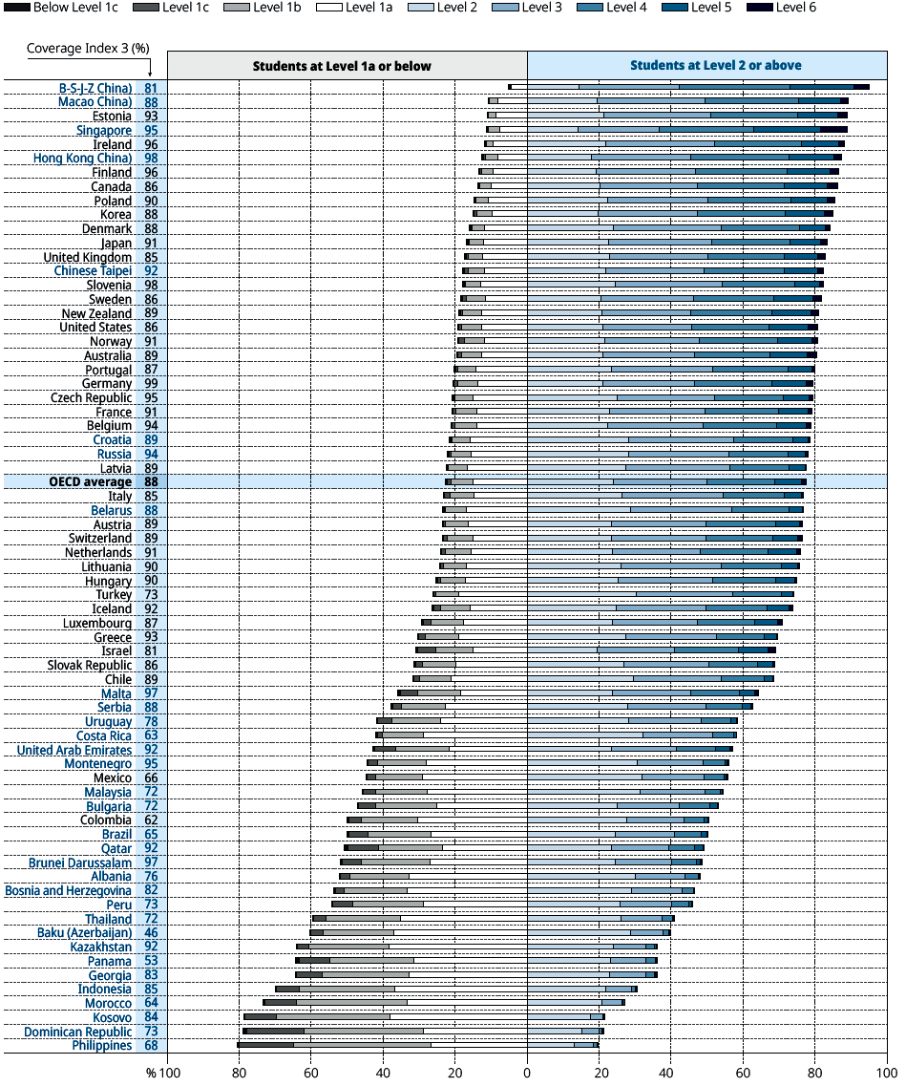
Achievements in Reading

Slide 15
PISA 2018 – Reading results
 | Achievement in reading: average | Reading subscale: Average result |  |  | Comparable capacities in reading Standard score: subscale of reading process …¹
 |  | Locate information | Understand | Evaluate and reflect | … Information locating (li) higher than… | … understanding (un) higher than… | … Evaluation and reflection(er) higher than…
OECD Average | 487 | 487 | 487 | 489 | un
Belarus | 474 | 480 | 477 | 473 | un er | er
Malta | 448 | 453 | 441 | 448 | un er |  | un
Serbia | 439 | 434 | 439 | 434 | er | li er
UAE | 432 | 429 | 433 | 444 |  | li | li un
Uruguay | 427 | 420 | 429 | 433 |  | li | li
Costa-Rica | 426 | 425 | 426 | 411 | er | er
Cyprus | 424 | 424 | 422 | 432 | un |  | li un
Montenegro | 421 | 417 | 418 | 416 | er | er
Mexico | 420 | 416 | 417 | 426 |  |  | li un
Bulgaria | 420 | 413 | 415 | 416
Malaysia | 415 | 424 | 414 | 418 | un er |  | un
Brazil | 413 | 398 | 409 | 419 |  | li | li un
Columbia | 412 | 404 | 413 | 417 |  | li | li un
Brunei | 408 | 419 | 409 | 411 | un er
Qatar | 407 | 404 | 406 | 417 |  |  | li un
Albania | 405 | 394 | 403 | 403 |  | li | li
Bosnia and Herzegovina | 403 | 395 | 400 | 387 | er | er
Peru | 401 | 398 | 409 | 413 |  | li | li un
Thailand | 393 | 393 | 401 | 398 |  | li er
Azerbaijan | 389 | 383 | 386 | 375 | er | er
Kazakhstan | 387 | 389 | 394 | 389 | er | er
Georgia | 380 | 362* | 374* | 379 |  | li | li un
Panama | 377 | 367 | 373 | 367 | er | er
Indonesia | 371 | 372 | 370 | 378 | un |  | un
Morocco | 359 | 356 | 358 | 363 |  |  | li un
Kosovo | 353 | 340 | 352 | 353 |  | li | li
Dominican Republic | 342 | 333 | 342 | 351 |  | li | li un
Phillipines | 340 | 343 | 335 | 333 | un er

Slide 16
Several factors on lack of success compared to PISA 2015
New test items/types in PISA 2018 (items based on text sources);
New format of test: CBA/CAT instead of printed tests in PISA 2018;
Statistical analysis of trending items results shows that difference between the group who wrote tests in CBA format in 2015 and 2018 is not statistically significant;
CBA items also require having ICT skills and therefore assesses them according to the factor analysis;
Limited access on ICT resources (See below).

Slide 17
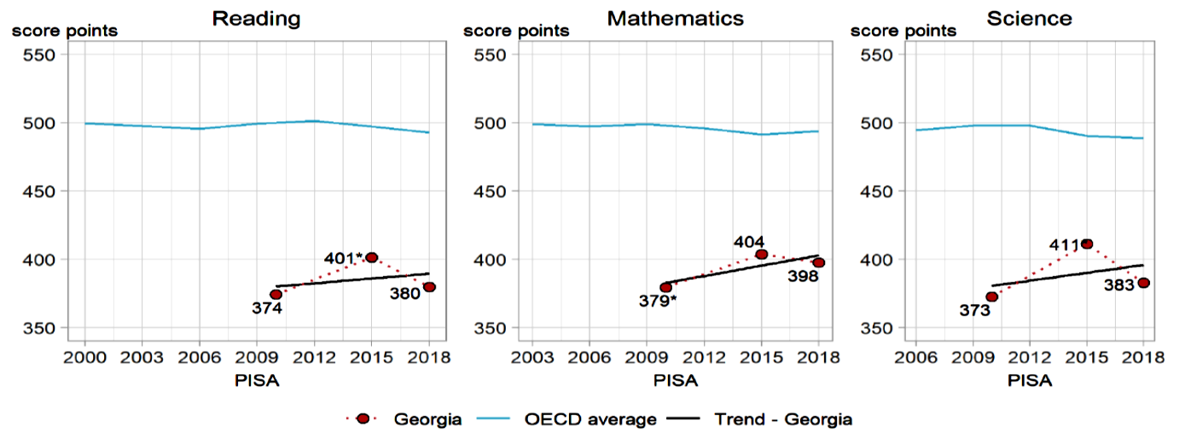
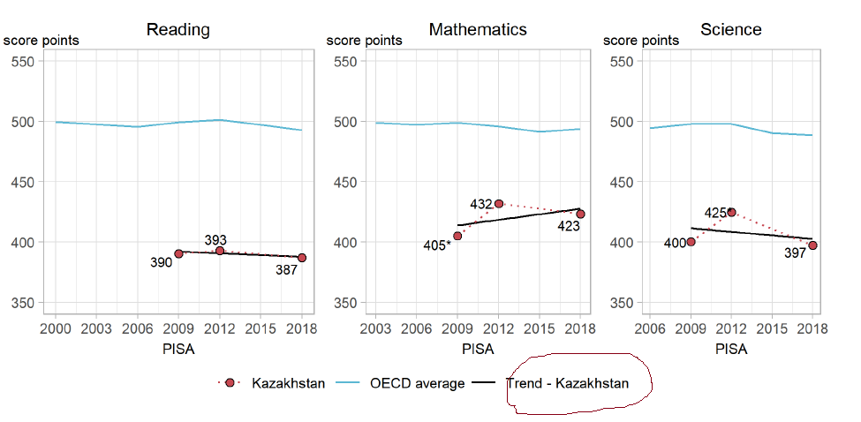
Long and short term tendencies:
Countries first participating in CBA in 2018 (1)

Slide 18
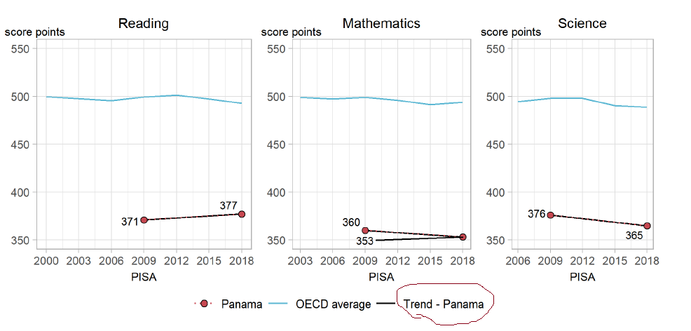
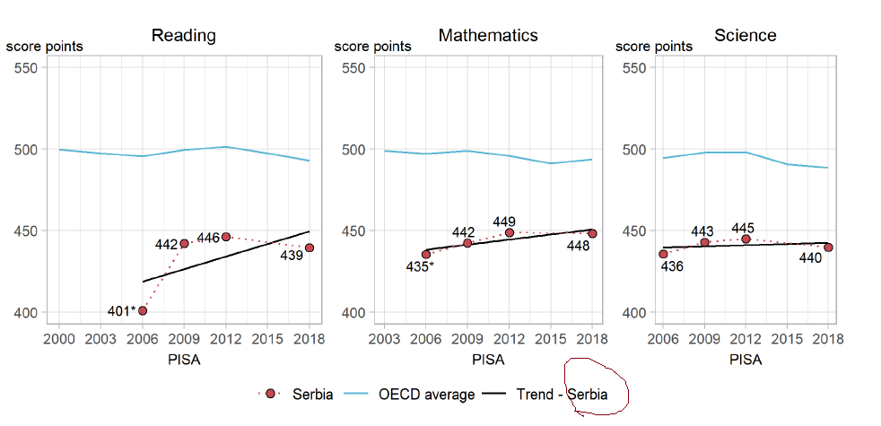
Long and short term tendencies:
Countries first participating in CBA in 2018 (2)

Slide 19
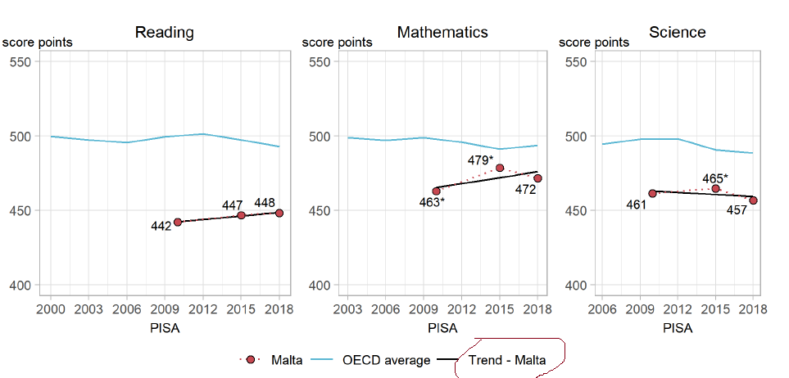
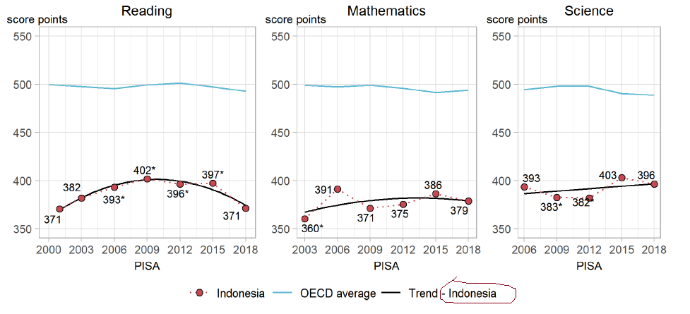
Long and short term tendencies:
Countries first participating in CBA in 2018 (3)

Slide 20
Achievements in Reading: PISA 2018 vs PIRLS 2016

Slide 21
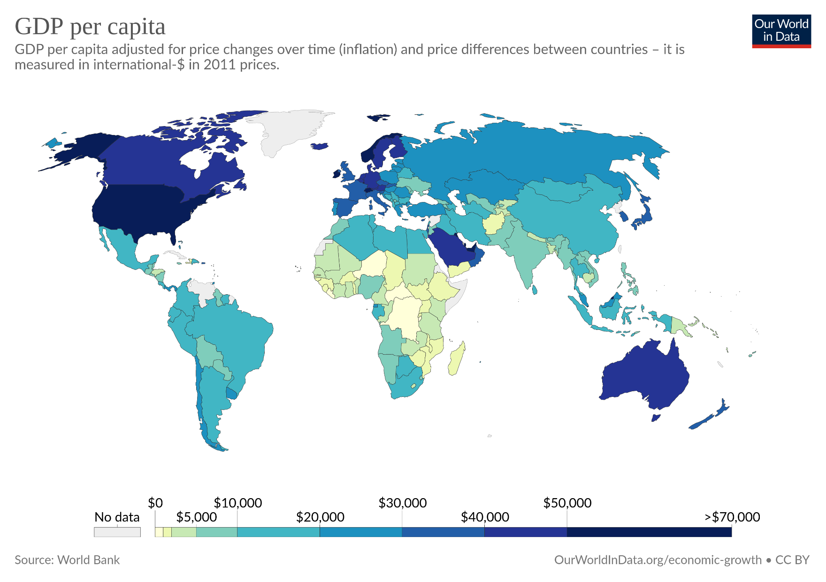

Slide 22
PISA 2018 – Countries grouped by economies according to the World Bank
37 members of OECD have developed economies;
Two from 42 partner countries ( Vietnam and Kosovo) are among low-middle income countries list. Other 47 countries from this category did not participate in the last PISA cycle;
Other 40, including Georgia are middle-low income countries. Other 31 from this category did not participate in PISA 2018).

Slide 24
Achievements in Reading: Countries with economies similar to Georgia
In comparison to countries with similar economies, the average reading performance rate of Georgian students:
outperforms students from Indonesia, Panama, Morocco, Kosovo, Lebanon, the Dominican Republic, and the Philippines;
is lower than the achievement of students from Albania, Baku (Azerbaijan), Belarus, Bosnia and Herzegovina, Colombia, Costa Rica, Moldova, Jordan, Serbia, Thailand, and Ukraine;
Albania, Georgia, Indonesia, Kazakhstan, Kosovo, Malta, Panama and Serbia fully switched to CBA in 2018;
Students from 9 countries: Argentina, Jordan, Lebanon, the republic of Moldova, the Republic of North Macedonia, Romania, Saudi Arabia, Ukraine and Vietnam wrote the tests in PBA format in all areas.

Slide 26
Achievements in Math
Country | Result | Country | Result | Country | Result | Country | Result
B-S-J-Z (China) | 591 | Germany | 500 | Croatia | 464 | Qatar | 414
Singapore | 569 | Czech Republic | 499 | Israel | 463 | Mexico | 409
Macao | 558 | Austria | 499 | Turkey | 454 | Bosnia and Herzegovina | 406
Hong-Kong | 551 | Latvia | 496 | Ukraine | 453 | Costa-Rica | 402
Taiwan | 531 | France | 495 | Greece | 451 | Jordan | 400
Japan | 527 | Iceland | 495 | Cyprus | 451 | Peru | 400
Korea | 526 | New Zealand | 494 | Serbia | 448 | Georgia | 398
Estonia | 523 | Portugal | 492 | Malaysia | 440 | Northern Macedonia | 394
Netherlands | 519 | Australia | 491 | Albania | 437 | Lebanon Columbia Brazil | 393 391 384
Poland | 516 | OECD Average | 489 | Bulgaria | 436
Switzerland | 515 | Russia | 488 | UAE | 435
Canada | 512 | Italy | 487 | Romania | 430 | Argentina | 379
Denmark | 509 | Slovakia | 486 | Montenegro | 430 | Indonesia | 379
Slovenia | 509 | Luxembourg | 483 | Brunei | 430 | Saudi Arabia | 373
Belgium | 508 | Hungary | 481 | Kazakhstan | 423 | Morocco | 368
Finland | 507 | Lithuania | 481 | Moldova | 421 | Kosovo | 366
Sweden | 502 | Spain | 481 | Baku (Azerbaijan) | 420 | Panama | 353
United Kingdom | 502 | USA | 478 | Thailand | 419 | Philippines | 353
Norway | 501 | Belarus | 472 | Uruguay | 418
Ireland | 500 | Malta | 472 | Chile | 417

Slide 27
Achievements in Math (average score 398 points)
Rating
According to the results of the PISA 2018 cycle, Georgia with an average score of 398 points is among the 46 countries (out of the total of 79 participating countries), where average student performance in Mathematics is substantially below the OECD 37 member countries average score (489 points).
Georgia ranks within the range of 63rd to 68th places (considering the margin of error) among the participating countries and within the range of 60th to 63rd among those 70 countries that participated in PISA computer-based mode (CBA).
Student Performance Distribution in Math according to achievement levels
39% of Georgian students attained the second or higher level of math proficiency (for comparison, the OECD average for same levels is 76%), only 1% of students demonstrated high proficiency (levels 5 and 6), while 61% of students have performed below the basic (second) level.
For the comparison:
In the 21 countries (including many low- and middle-income countries), more than 50% of students performed at the same unsatisfactory level;
24% of students from OECD countries are in the so-called “low achievement group” (below the second level of achievement), whereas 11% of students fall in the category of so-called “high performers” (Levels 5 and 6).

Slide 28
Achievements in Natural Sciences
Country | Result | Country | Result | Country | Result | Country | Result
B-S-J-Z (China) | 590 | Czech Republic | 497 | Turkey | 468 | Costa-Rica | 416
Singapore | 551 | Ireland | 496 | Slovakia | 464 | Montenegro | 415
Macao (China) | 544 | Switzerland | 495 | Israel | 462 | Columbia | 413
Estonia | 530 | Denmark | 493 | Malta | 457 | Northern Macedonia | 413
Japan | 529 | France | 493 | Greece | 452 | Brazil | 404
Finland | 522 | Portugal | 492 | Chile | 444 | Argentina | 404
Korea | 519 | Norway | 490 | Serbia | 440 | Peru | 404
Canada | 518 | Austria | 490 | Cyprus | 439 | Bosnia and Herzegovina | 398
Hong-Kong (China) | 517 | OECD Average | 489 | Malaysia | 438 | Baku (Azerbaijan) Kazakhstan Indonesia | 398 397 396
Taiwan (China) | 516 | Latvia | 487 | UAE | 434
Poland | 511 | Spain | 483 | Brunei | 431
New Zealand | 508 | Lithuania | 482 | Jordan | 429 | Saudi Arabia | 386
Slovenia | 507 | Hungary | 481 | Moldova | 428 | Lebanon | 384
United Kingdom | 505 | Russia | 478 | Romania | 426 | Georgia | 383
Australia | 503 | Luxembourg | 477 | Uruguay | 426 | Morocco | 377
Germany | 503 | Iceland | 475 | Thailand | 426 | Panama | 365
Netherlands | 503 | Croatia | 472 | Bulgaria | 424 | Kosovo | 365
USA | 502 | Belarus | 471 | Mexico | 419 | Philippines | 357
Sweden | 499 | Ukraine | 469 | Qatar | 419
Belgium | 499 | Italy | 468 | Albania | 417

Slide 29
Achievements in Science (average score 383 points)
Rating
In the domain of science Georgia with an average score of 383 points is among the 49 countries (out of the total of 79 participating countries), where average student performance is substantially below the OECD average score (489 points).
Georgia ranks within the range of 71st to 74th (considering the margin of error)among the participating countries and within the range of 65th to 66rd among those 70 countries that participated in PISA computer-based mode (CBA).
Student Performance Distribution in Science according to achievement levels
36% of Georgian students attained the second or higher level of science proficiency (for the comparison, the OECD average for the same levels is 78%). Less than 1% of students demonstrated high proficiency (levels 5 and 6) in science, while 64% of students have performed below the basic (second) level.
For the comparison:
In the 21 countries (including many low- and middle-income countries), more than 50% of students performed at the same unsatisfactory level;
24% of students from OECD countries are in the so-called “low achievement group” (below the second level of achievement), whereas 11% of students fall in the category of so-called “high performers” (Levels 5 and 6).

Slide 30


Difference related to gender
 | Georgia | OECD
Reading | 38* points | 30 points
Math | 4 points | 5 points
Natural Sciences | 14* points | 2 points

Slide 31
Differences in student performance by school characteristics and by the language of the test
after controlling for the interaction of school characteristics (language of the test, location of settlement and school type) and students’ socio-economic background variables, the effect of school location and school type disappears. At the same time, the language of the test still represents an important factor. Students, who have completed the test in the Azeri language scored lower in reading compared to their Georgian-language peers.
Differences in student performance by school characteristics
The average student achievement scores by the school type are: public - 374* (S.E. = 2.3), private - 427 (S.E. = 6.0); However, the difference between these two indicators (Diff = -53) (S.E. = 6.5) is statistically significant (P = 0.001);
Average student achievement scores by school location are: Rural: 350* (S.E. = 3.4); small town: 365 (S.E. = 9.5); town: 369* (S.E. = 4.3), City: 392 * (S.E. = 5.4), Large City: 412* (S.E. = 4.9);
• Average student achievement scores by school size are as follows: Less than 15 students: 368* (SE = 4.9), 16-20 students: 380 (SE = 9.0), 21-25 students: 383* (SE = 6.0), 26 -30 students: 392* (SE = 4.7), 31-35 students: 380 (SE = 9.2), 46-50 students: 380 (SE = 14.4).
(Note that values that are statistically significantly from Country’s average scores of 380 are marked with the * symbol)

Slide 32
Differences in student performance by school characteristics and by the language of the test
In Pisa 2019, as in Pisa 2015 language of the test was an important factor. Students who wrote test in Azerbaijani have lower results on average.
Teaching language | N | % | %(S.E.) | Average in reading | Average S.E. | St.Dev | St.Dev (S.E.)
Georgian | 5153 | 93.2 | 0.97 | 383.95 | 2.13 | 82.93 | 1.22
Azerbaijani | 298 | 4.71 | 0.73 | 287.57* | 5.29 | 58.83 | 2.8
Russian | 121 | 2.1 | 0.77 | 399.93** | 12.08 | 72.94 | 5.22
Teaching language | N | % | %(S.E.) | Average in Math | Average S.E. | St.Dev. | St.Dev (S.E.)
Georgian | 5153 | 93.2 | 0.97 | 401.48 | 2.54 | 87.16 | 1.65
Azerbaijani | 298 | 4.71 | 0.73 | 309.4* | 7.88 | 68.44 | 3.39
Russian | 121 | 2.1 | 0.77 | 422.6** | 17.25 | 79.68 | 6.42

Slide 33
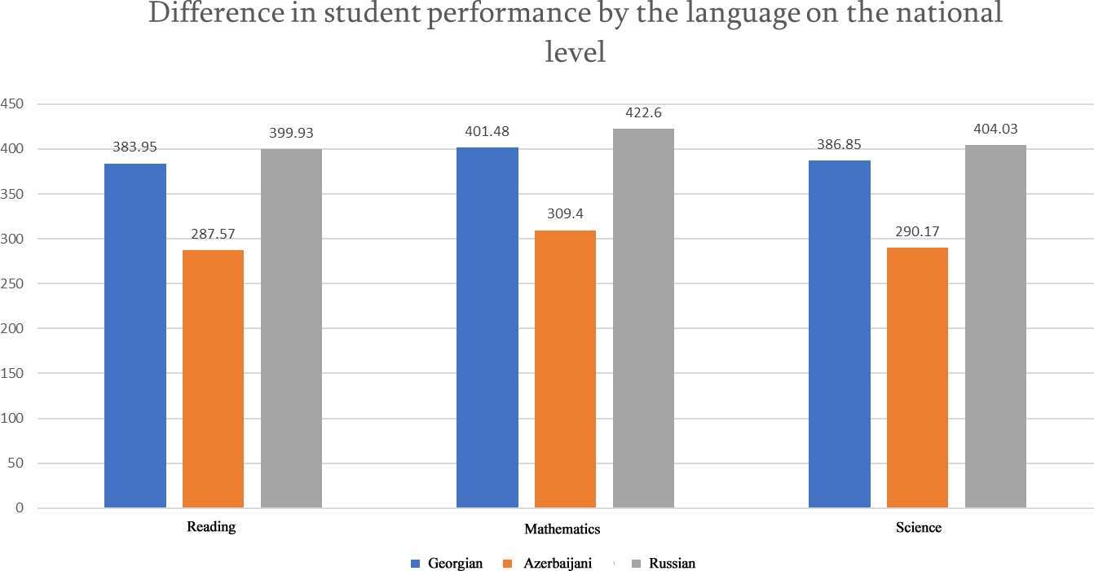
Differences in student performance by school characteristics and by the language of the test

Slide 34
Equality: Positive tendencies
Gender based difference in reading (38 points) in 2018 is lower than in 2009 (61 points);
In Georgia, difference between socio-economically advantaged and disadvantaged students results in reading (68 points) is lower than in OECD member countries (89 points);
Difference between socio-economically advantaged and disadvantaged students results in reading in 2018 (68 points) is lower than in 2009 (87 points).

Slide 35
Thank you for your attention!

